Slide 1
Weather Conditions and Climate Change with Climate Wins
Data Specialization
November 20, 2024
Kendra Jackson

Slide 2
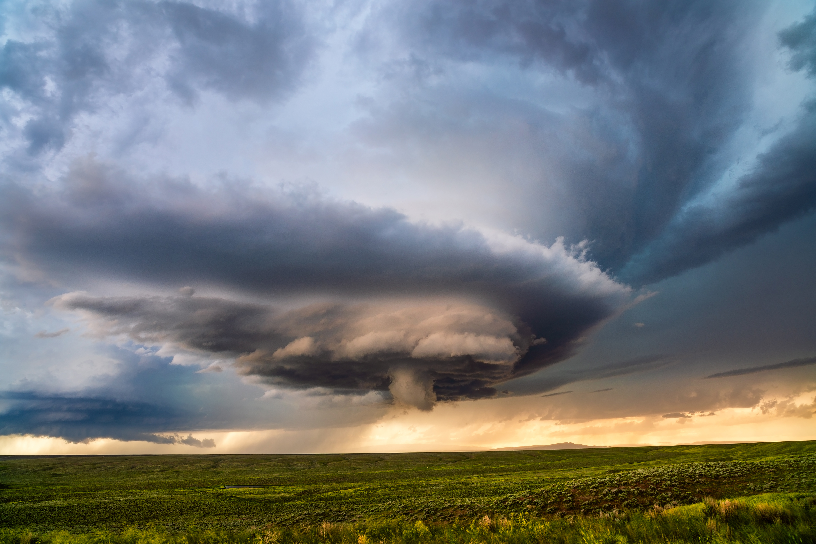
Objective
The company, ClimateWins, is a nonprofit European organization. Their main concern is an increase in extreme weather events, especially those within the previous 10-20 years. However, ClimateWins wants to incorporate machine learning into their analysis of climate data. Their hope is to utilize historical data and machine learning to predict the consequences of climate change, including extreme weather events, within Europe and, potentially, the world.

Slide 3

Hypothesis
Machine learning models trained on historical climate data can accurately predict an increase in average daily temperatures across Europe within the next 5 years.
Machine learning algorithms can identify patterns and correlations between different extreme weather conditions (Ex. Heatwaves and wildfires, heavy rainfall and flooding) and predict the likelihood of one event occurring given the presence of another
Machine learning models utilizing real-time and historical weather data can effectively predict the occurrence, intensity, and location of extreme weather events (ex. Floods, typhoons, droughts) with a higher accuracy than traditional forecasting methods
Warmer temperatures correlate positively with occurrence of pleasant weather days while colder temperatures, winds, snow, rain, and the like correlate to unpleasant weather days

Slide 4

The Data
Collected through hurricane predictions from the The National Oceanic and Atmospheric Administration (NOAA), an American company, and typhoon data from The Japan Meteorological Agency (JMA) in Japan, world temperatures, and a “great deal of other data”.
The Dataset
Based on weather collected from 18 weather stations across Europe
Collected information across a period ranging from the late 1800s to 2022.
Records were made almost daily
Values recorded included temperature, wind speed, snow, global radiation, and more
Collected by the European Climate Assessment & Data Project
Downloadable Dataset Link

Slide 5

Data Bias
Collection Bias
Over 26,000 weather stations exist across Europe, data was collected from only 18. The sampled weather stations may not accurately represent the diverse climates across Europe.
Location Bias
Data is centralized to Europe; predictions may not be capable of generalizing and therefore predict accurately in other regions like Russia, Canada, or Chile.
Sampling Bias
Selection of limited stations can skew the results due to inaccurate representation of regional data
Temporal Bias
Data range spans a period of over 150+ years, historical conditions may no longer represent current conditions and may mislead the algorithm to determine more milder weather
Data Prediction Accuracy
Accuracy depends on Machine Learning Algorithm applied to historical data
KNN (Best Fit) ~ 88% (Test Data)
Decision Tree ~ 47% (Test Data)
Requires pruning
Artificial Neural Network ~ 50% (Test Data)

Slide 6
Data Optimization
Data optimized through Gradient Descent
Gradient Descent was utilized to find a local minimum or “valley” within the data, this function represents error within a model.
For this data, gradient descent was applied to find the minimum error, this was completed by adjusting iteration, Theta values, and step size.
Results near to 0 were achieved
When lower error is achieved, the model fits the data better and can therefore make more accurate predictions

Slide 7
Machine Learning Algorithms
K-Nearest Neighbour (KNN)
Decision Tree
Artificial Neural Network (ANN)

Slide 8
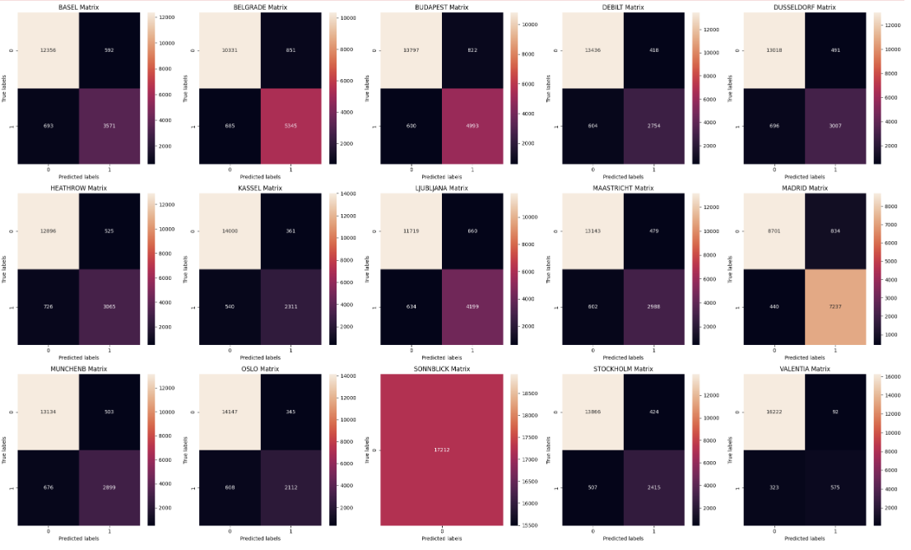
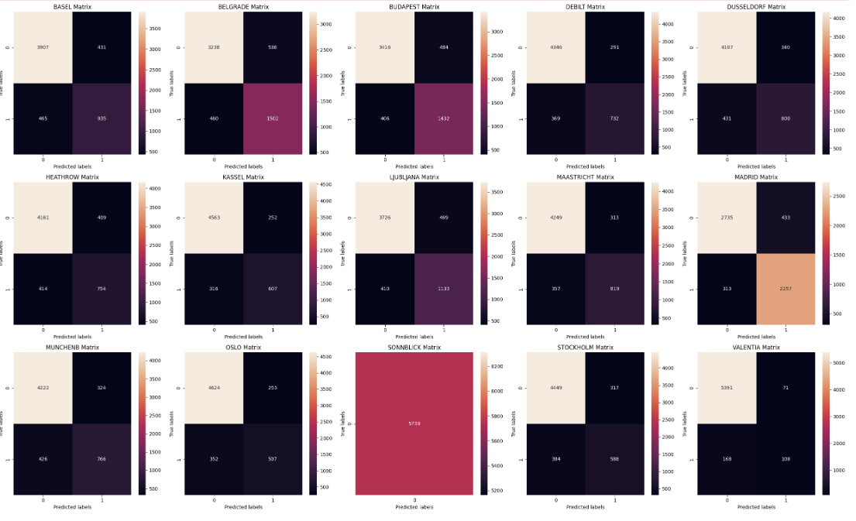
K-Nearest Neighbour (KNN)
Training Dataset (Accuracy)
Testing Dataset (Accuracy)
Assigns distance to other data points from a selected data point
Looks at an assigned value of nearest data points (Ex. Looks at 3 closest “neighbours”)
Makes a prediction based on the “neighbours” or data points closest to it

Slide 9
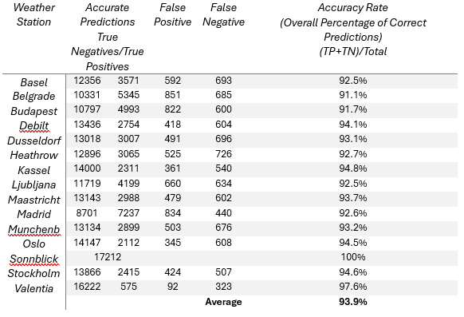
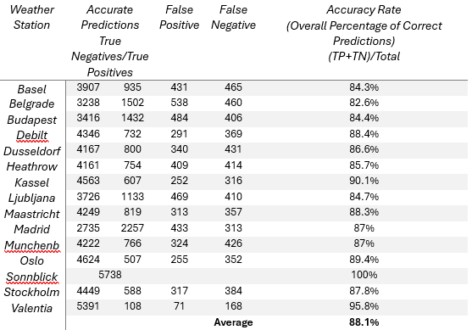
K-Nearest Neighbour (KNN)
Training Dataset (Accuracy)
Testing Dataset (Accuracy)
The algorithm is better at predicting true negatives, or unpleasant weather, suggesting it may work better for this type of prediction
The model had slightly more difficulty predicting true positives, or pleasant weather
Overall testing accuracy sits around 88%
Sonnblick had 100% accuracy, this leads to the suspicion that the model may be overfit and has learned this specific data too well. This means its performance may worsen on new data.

Slide 10
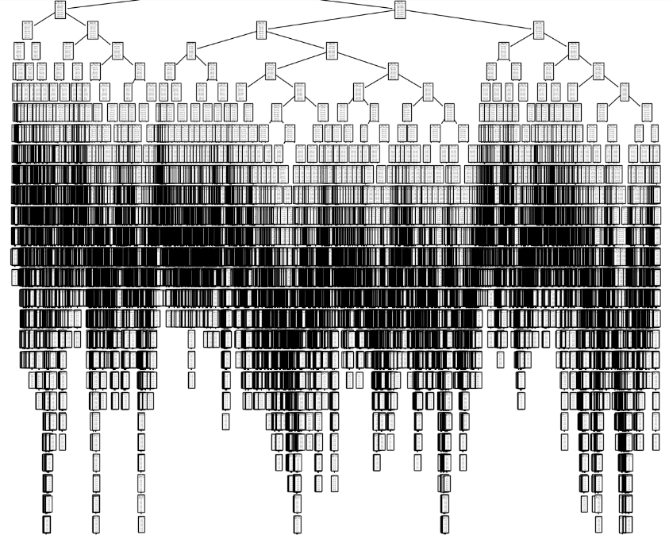
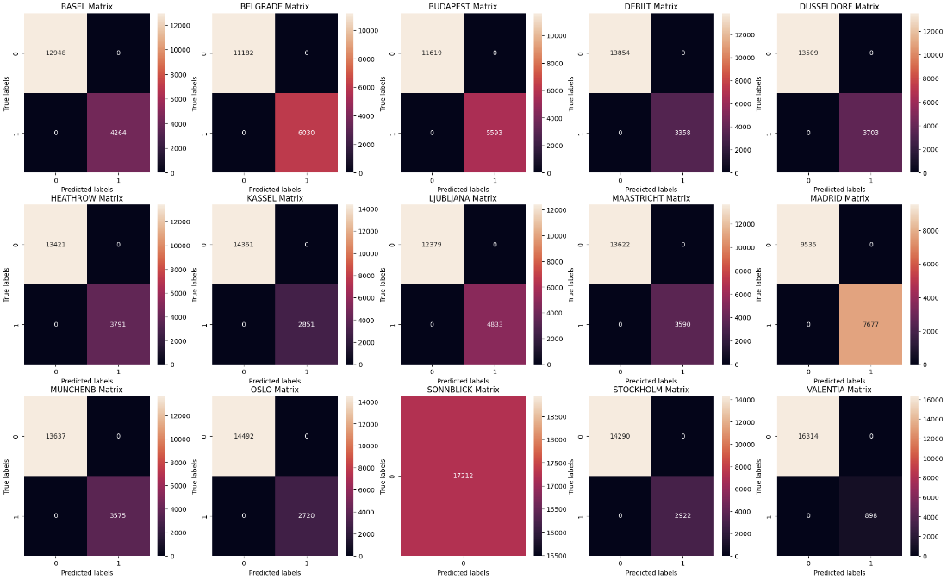
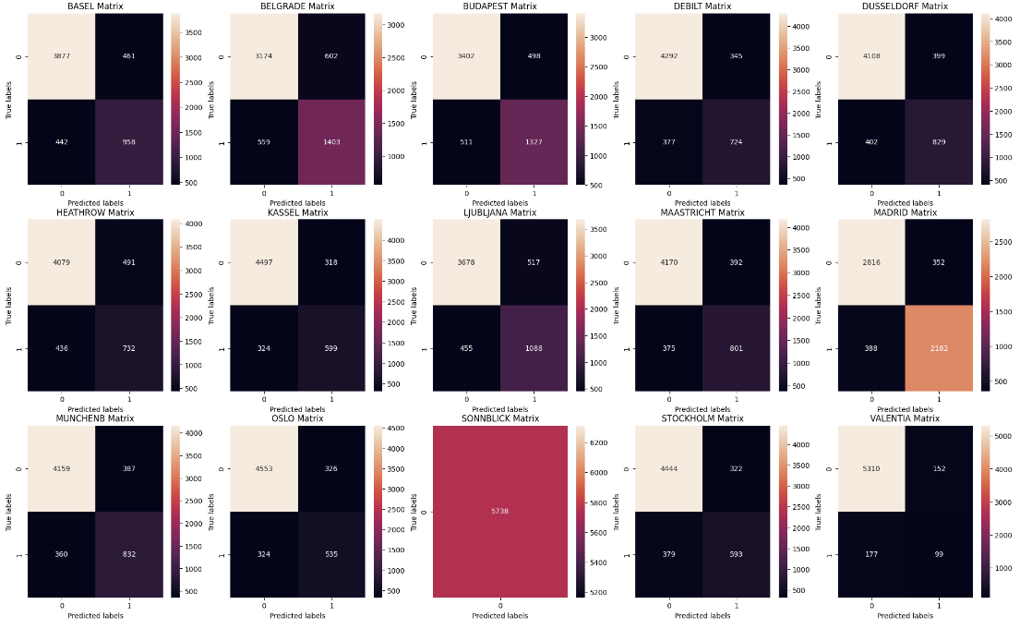
Decision Tree
Training Dataset (Accuracy)
Testing Dataset (Accuracy)
The accuracy score was ~47% for testing data
The decision tree is likely overfit due to its excessive depth and complexity
The decision tree is likely asking too many specific questions causing it to be inefficient
The decision tree needs to be pruned and then its accuracy reassessed, for now it is not a good choice of a model

Slide 11
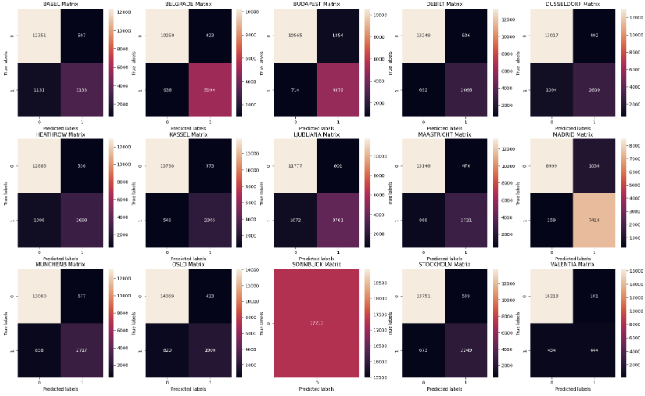
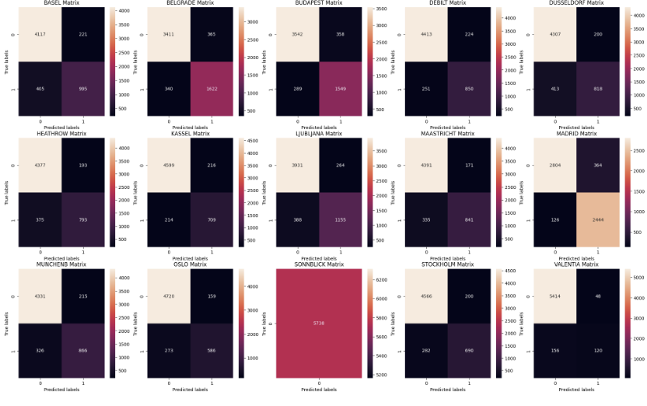
Artificial Neural Network (ANN)
Training Dataset (Accuracy)
Testing Dataset (Accuracy)
Performed multiple scenarios to determine how changing hyperparameters of this machine learning algorithm may affect model accuracy
The most accurate trial yielded an accuracy for testing data of ~50%
Similar to other algorithms, Sonnblick achieved an accuracy of 100%

Slide 12
Conclusion and Next Steps
Findings thus far demonstrate the ability of machine learning to accurately predict certain weather events, this indicates that machine learning could be able to predict adverse and extreme events as well, aligning with our hypothesis.
The KNN model appears to work the best for this data as it has the highest test accuracy.
The decision tree model is likely overfit and requires pruning which may lead to improvement
Prune
Prune the Decision Tree Model to improve accuracy and reduce overfitting.
Explore
Trial methods that combine models to improve accuracy. Models can include both supervised and unsupervised as well as previously explored models.
Discover
Utilize unsupervised machine learning models to identify previously unfound patterns and differences in weather data.

Slide 13


Thank you
Any Questions?
Please Contact me below:
Kendra Jackson
Or Visit:

